Slide 1
Performance & Engines
Systems for Human Data Interaction - Fall 2021

Slide 2
Motivation
Interactive visualization is being applied to increasingly large (in terms of # of rows) data sets
Many visualization techniques assume that data is small enough to avoid scaling concerns
This paper: a literature review
What’s the space of possibilities for optimization?
Find visualization & HCI papers from the past 20 years, cluster on what database optimizations they use
Conduct a literature search in databases papers for these database optimizations
Use Brehmer & Munzner’s typology to categorize interactive visualization behaviors

Slide 3
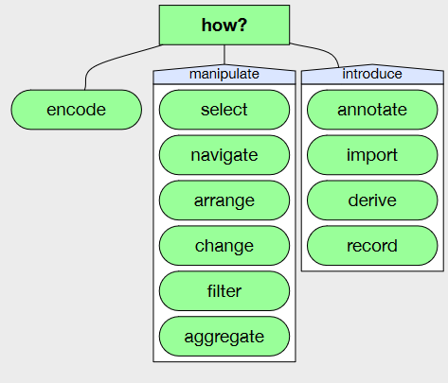
Review: The how part of Brehmer & Munzner’s typology

Slide 4
Six Optimization Techniques
Materialized Views
Approximate Query Processing
User Modeling & Query Prediction (skipped)
Multi-Query Optimization
Lineage/Provenance
Indexing (skipped)
As we go over these, which optimizations jump out as being obviously applicable? To which part of Brehmer & Munzner’s typology?

Slide 5
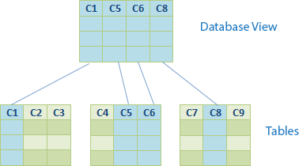
Materialized Views
View:
CREATE VIEW MyView AS [...regular SQL SELECT query]
Used to provide an interface to database (a way to “view” it) that looks like a table but isn’t a real table
Simplify queries, provide an abstraction to not depend on table “implementation details”
Doesn’t actually speed up your queries
SELECT C1, C5, C6, C8
FROM Table1
JOIN Table2 ON table1.id = table2.id
JOIN Table3 ON table2.id = table3.id
SELECT C1, C5, C6, C8
FROM MyView
Kylin Soong
http://ksoong.org/database/2014/08/15/sql-view/

Slide 6
Materialized Views
Materialized View:
CREATE MATERIALIZED VIEW MyMaterializedView [DBMS-specific configuration] AS [...SQL SELECT query]
Similar to a view: provides an interface
But also store it, and recompute it sometimes to keep it fresh
Does actually speed your queries
When to refresh it is a problem. A materialized view is a cache, and cached data can become stale.

Slide 7
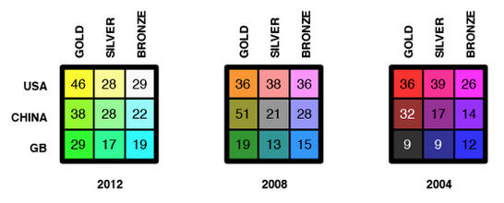
Materialized Views: Data Cubes
We have some data set that has many dimensions stored in some tables
The shape of the table makes it easy to query along certain axes
How do you answer the question
Sarah Roberts
https://medium.swirrl.com/how-the-olympics-explains-multidimensional-data-8e58b127edb2

Slide 8
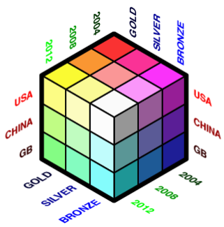
Materialized Views: Data Cubes
Precompute data points along every combination of categories in every dimension
Data Cube assembly can take quite a long time! Depends on dimensionality of and # of rows in the data set
Doesn’t actually have to be 3 dimensions
Sarah Roberts
https://medium.swirrl.com/how-the-olympics-explains-multidimensional-data-8e58b127edb2

Slide 9
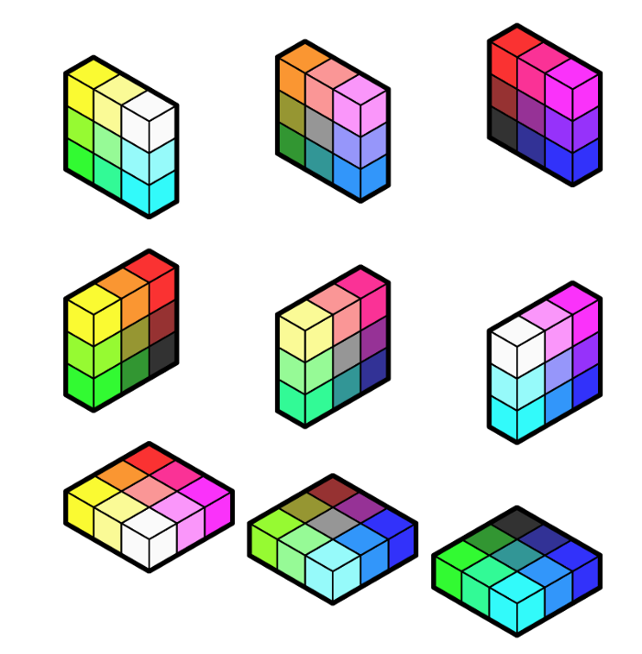
Materialized Views: Data Cubes
Now we’re free to get “slices” of the cube by choosing values for some of the dimensions
Since generating the Data Cube involved pre-computing the data point at every single combination of categories in every dimension, this is all just lookups
Sarah Roberts
https://medium.swirrl.com/how-the-olympics-explains-multidimensional-data-8e58b127edb2

Slide 10
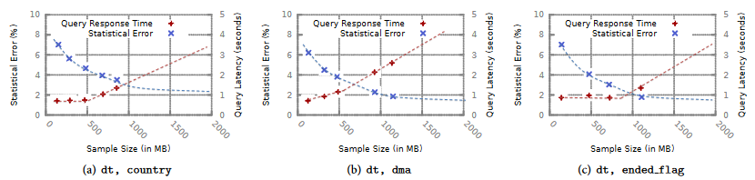
Approximate Query Processing
We don’t always need perfectly correct answers to queries, especially for visualizations
Query latency might be more important than correctness. There’s a trade-off between correctness and latency
Agarwal et al., BlinkDB, 2013

Slide 11
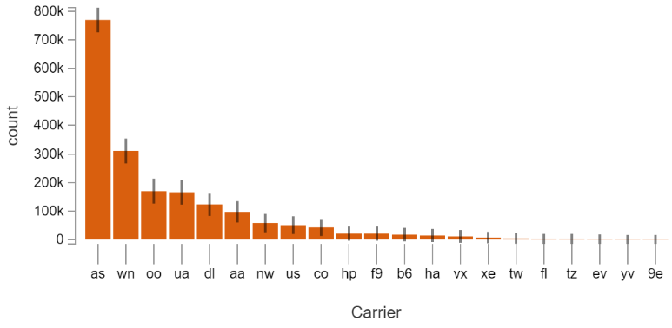
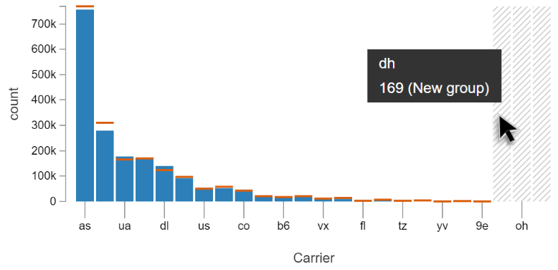
Approximate Query Processing
Left: approximate results, with confidence intervals. Right: precise results (blue) vs. approximate (orange)
Moritz et al., Trust, but Verify (Pangloss), 2017

Slide 12
Multi-Query Optimization
Visualization recommendation is a good example of a situation where we might have many queries dispatched simultaneously, operating on the same/similar data
If we have multiple queries executing simultaneously as a batch some of them might end up doing overlapping work
Same/overlapping WHERE clauses on the same table
Same JOIN between two tables
Finding the global optimum is (formally) a hard problem! The space of possible query plans grows exponentially with the size and number of queries
Many solutions use heuristics
Optimize queries individually, then try to combine
Sellis, Multiple-Query Optimization, 1988

Slide 13
Lineage/Provenance
Bi-directional relationship between input and output rows
Which input rows generated this output row?
Which output rows are generated from this input row?
Two Phases:
Lineage Capture: save lineage information as queries are executing
Lineage Query: use captured lineage information to answer a question
Two general approaches:
Logical: rewrite queries to capture lineage information in a table
Physical: instrument the query execution to save lineage in non-table data structures
Performance cost is non-trivial: we’re adding work to queries!

Slide 14
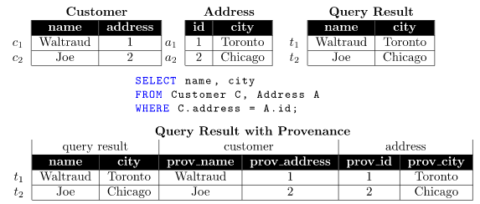
Lineage/Provenance
Logical lineage capture (query rewriting)
Glavic et al., Perm, 2009

Slide 15
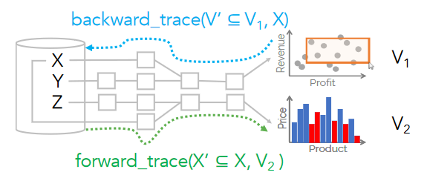
Lineage/Provenance
A motivating use case: linked brushing from one visualization to another
Psallidas & Wu, Smoke, 2018

Slide 16
Literature Review Methodology
Look at visualization & HCI papers published at major conferences from the last 30 years that use database optimization techniques
Cluster papers on what optimization techniques are used
Look at database papers directly cited by papers in the clusters, and search for additional papers published at major databases conferences related to the optimization techniques
Produce a table:
Rows: Operations from how part of Brehmer & Munzner’s typology
Columns: Database optimization techniques
Each cell: which papers are at this intersection of how & optimization
Cell color: “maturity” bin

Slide 17
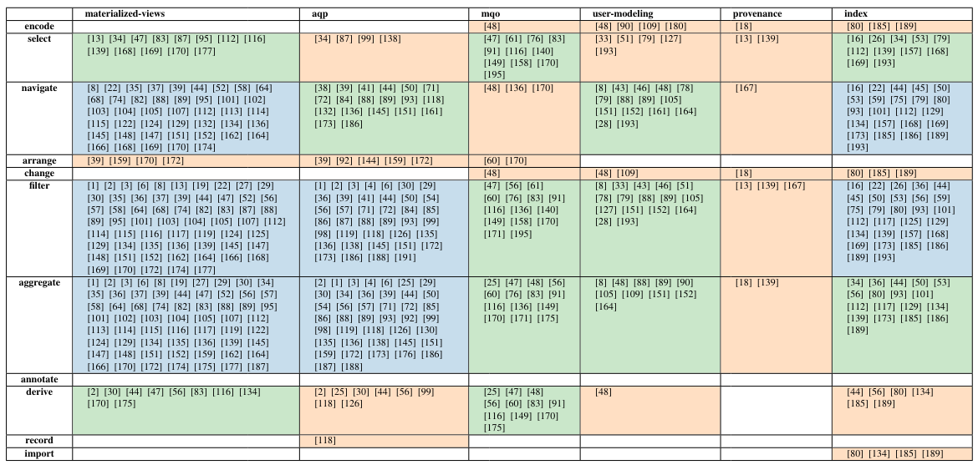

Slide 18
Levels of Maturity
Observations: Establish that performance problems exist by providing an example use case
Need to know what the problem is and what possible solutions are
Benchmarks are a good way to compare solutions
Algorithms: Solve an existing performance problem
Formalize a theory of interaction
Enables communication with other fields of study
Systems: Generalize algorithms and make solutions more broadly accessible
How do you go from algorithms to systems? What’s available in major DBMSes?
Authors argue for publishing optimizations as software packages that are usable independent of DBMSes

Slide 19
Unexplored Gaps - Optimization
Multi-Query Optimization
Might be due to the large search space of potential future queries
Visualization might be a constrained enough query surface area to cover
User Modeling
Dependent on availability of provenance information
Provenance
Most provenance visualization research is about showing provenance to the user
Few systems collect large amounts of provenance information
Unclear what you can use provenance information for (both for optimization and user modeling)

Slide 20
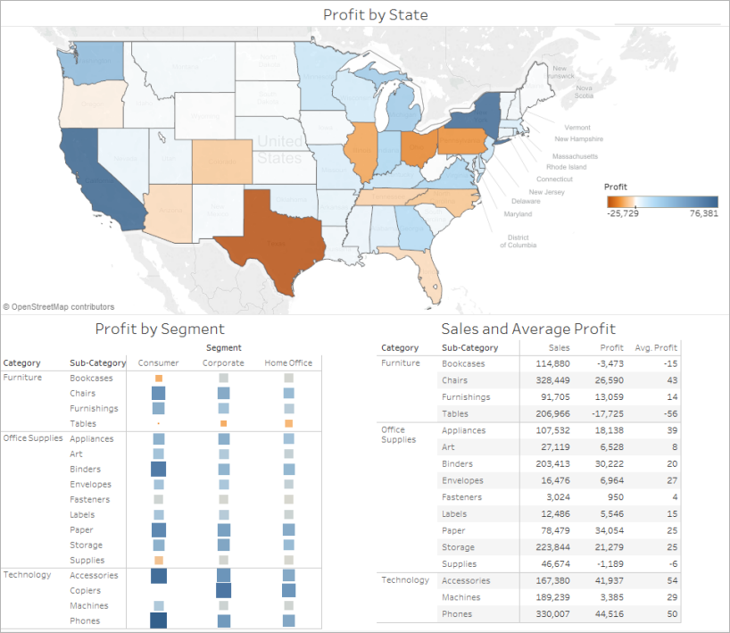
annotate/record
annotate: add graphical/textual annotations to visualization elements, possibly save as attribute in database
record: save visualization elements as a persistent artifact (screenshots, notebook, dashboard)
Best Practices for Effective Dashboards - Tableau
https://help.tableau.com/current/pro/desktop/en-us/dashboards_best_practices.htm

Slide 21
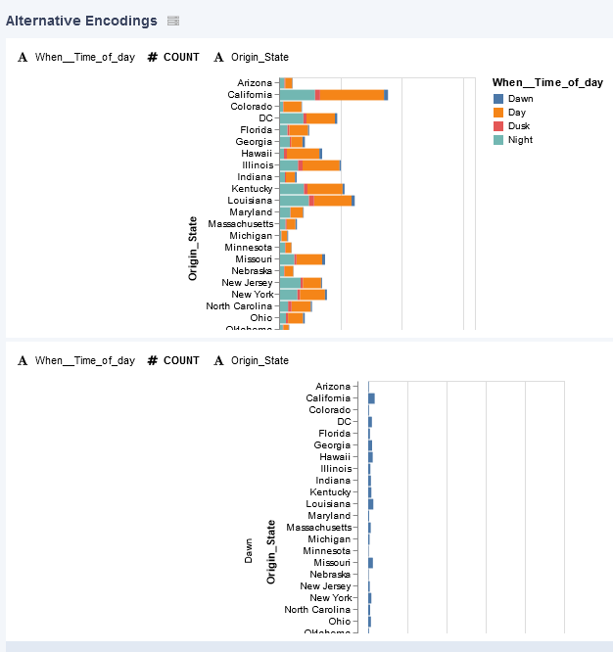
encode/change
encode: how is data initially mapped to a visual representation?
change: alter the visual encoding (alter chart visual features, switch chart type)
Voyager 2
https://vega.github.io/voyager/

Slide 22
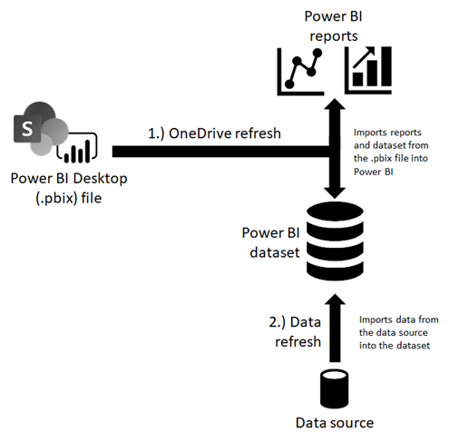
import
import: add new elements to the visualization, including new data elements.
Data refresh in Power BI
https://docs.microsoft.com/en-us/power-bi/connect-data/refresh-data

Slide 23
Unexplored Gaps - Interaction
annotate, record
Don’t produce much data, DBMS optimizations aren’t necessary
encode, change
Surprising lack of research!
Many papers hardcode visualizations or used a fixed set of templates
Recommend more research on supporting encode and change with big data
import
Existing papers are all from industry
A lot of visualization papers assume that data has already been imported

Slide 24
Discussion
What optimization/how intersection seems like the most promising avenue for research?
This paper uses the how part of Brehmer & Munzner’s typology of visualization tasks.
Now that it’s being used to search for visualization optimization techniques, what do you think about its coverage/applicability?
Are there how operations that are missing from a complete visualization flow?
Do you find this literature review methodology compelling?
Are the insights about “gaps” in the table valid?
Are there visualization performance gaps not identified by this method?

